Slide 1
Measuring Stellar Elemental Abundance
By Erin Bernthold, Roland Hebner, and Lucas Ferrari

Slide 2
Motivation
1
Goal 1
To understand the curve-of-growth method for measuring stellar abundance and appreciate its significance in practical research applications.
2
Goal 2
To comprehend the Boltzmann and Saha equations and apply them effectively in stellar abundance measurements.
3
Goal 3
To present stellar abundance measurements in a clear and accessible manner for physicists and astronomers.

Slide 3
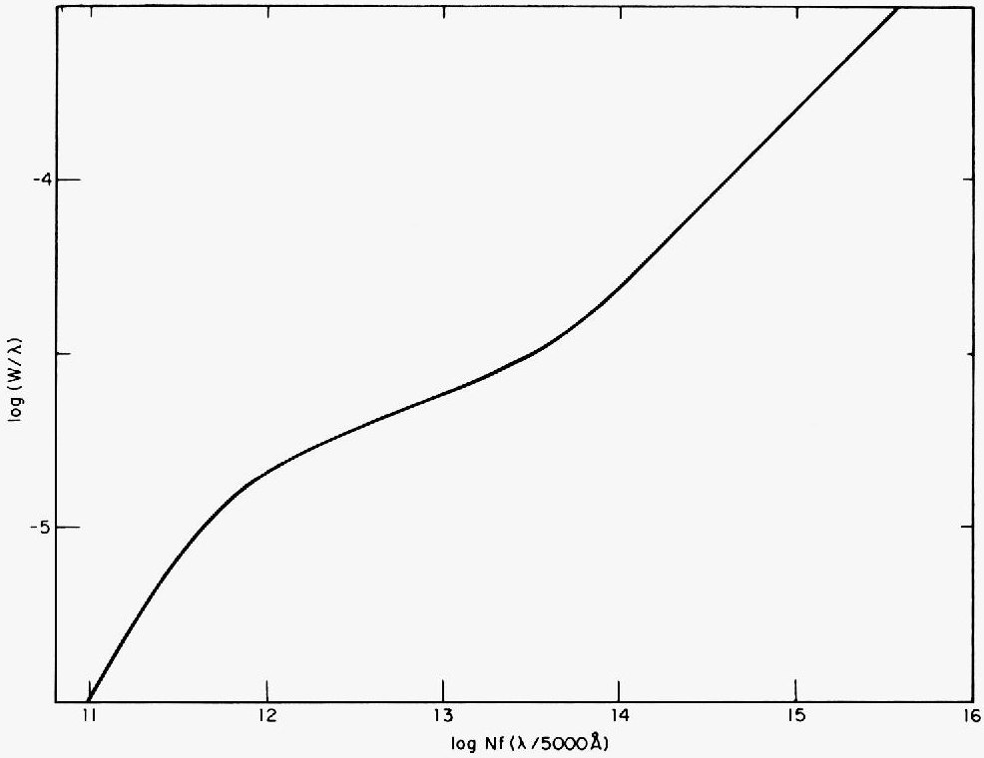
Methodology
First, we plotted the solar spectrum to determine the bounds for the ground-state transition to calculate the area above the curve. This helped us to solve for the number density of Na, Mg, and Fe .
Then, we defined a function for the Boltzmann equation to estimate the ratio of atoms for these elements in the ground state versus an excited state.
To approximate a ratio of neutral atoms to ionized atoms, a function for the Saha equation was defined.
Finally, a function was created to measure the equivalent width of one of the solar doublets of Na, Mg, and Fe and interpolate the curve of growth for more consistency.

Slide 4
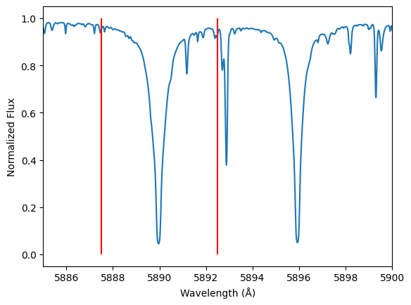
Sodium (Na)
Area Bounds
Curve
Represented by the red lines, the bounds are λ=5887.5 Å and λ=5892.5 Å.
The blue curve represents the solar spectrum for sodium from λ=5884 Å to λ=5900 Å
This is a plot of the solar spectrum for sodium.

Slide 5
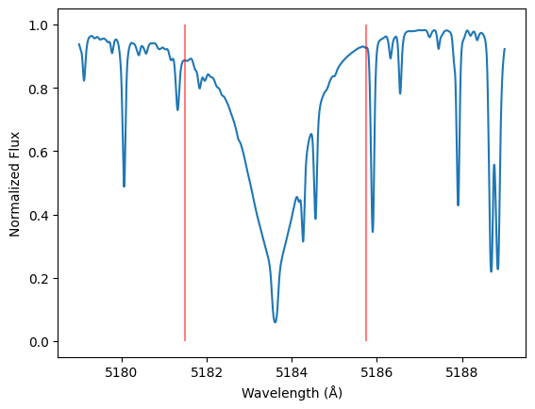
Magnesium (Mg)
Area Bounds
Curve
Represented by the red lines, the bounds are λ=5181.4 Å and λ=5185.8 Å.
The blue curve represents the solar spectrum for sodium from λ=5178 Å to λ=5190 Å
This is a plot of the solar spectrum for magnesium.

Slide 6
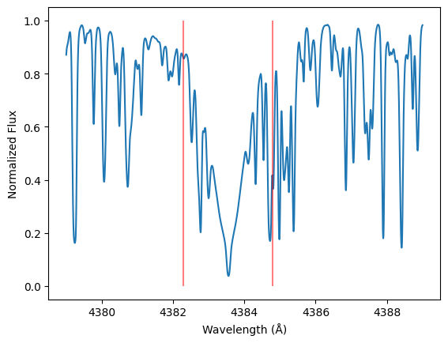
Iron (Fe)
Area Bounds
Curve
Represented by the red lines, the bounds are λ=4382.5 Å and λ=4384.9 Å.
The blue curve represents the solar spectrum for sodium from λ=4378 Å to λ=4390 Å
This is a plot of the solar spectrum for iron.

Slide 7
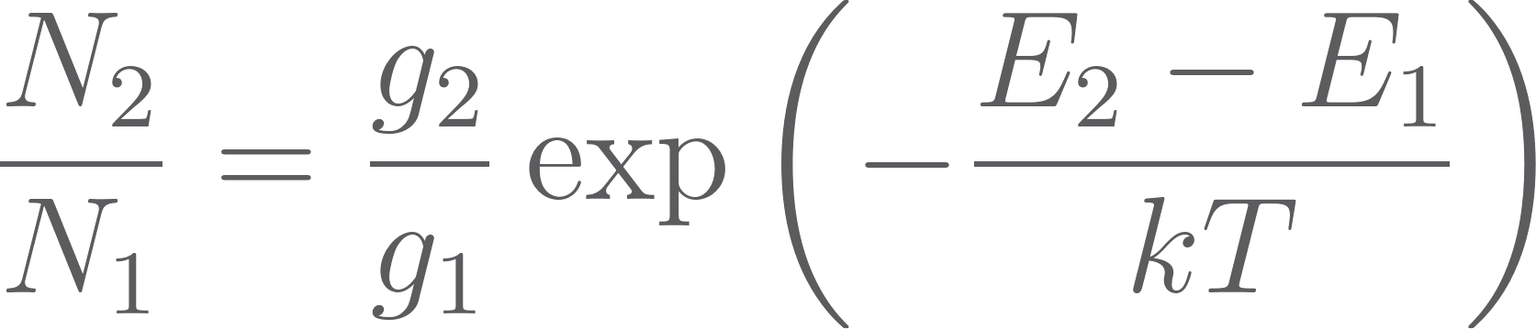
Important Equations
The Boltzmann Equation
Subscripts 1 and 2 refer to 3s and 3p states, N is the number density, g is the number of separate states that are degenerate in energy, E is the energy at that state, k is the Boltzmann constant, and T is the temperature.

Slide 8



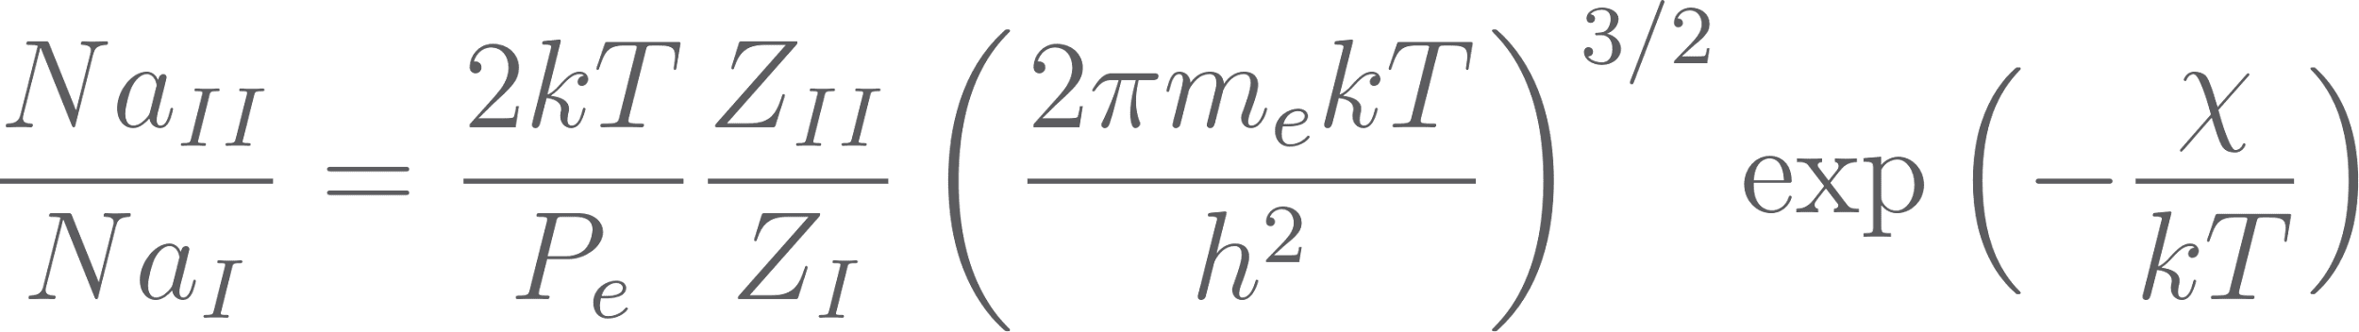
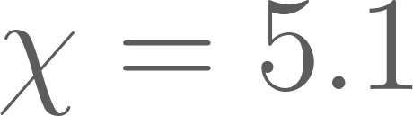
Important Equations
The Saha Equation
is the electron mass, partition function and ,
electron pressure
, and the
ionization energy eV.
These are the given values for the sodium line.

Slide 9
Important Equations
Oscillator Strength
i refers to the lower energy level, k refers to the upper level, λ is the wavelength in Angstroms, and
g = 2J+1 for a given level. This equation was used to find the oscillator strength for both iron and magnesium.

Slide 10
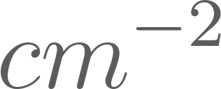
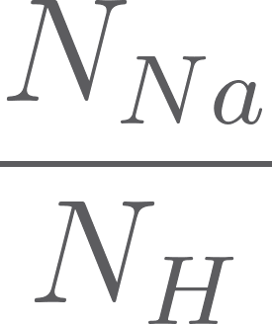
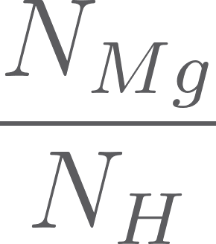
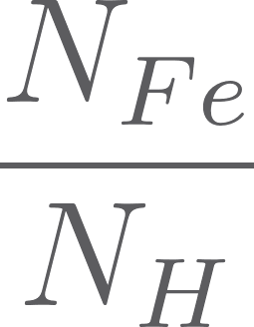
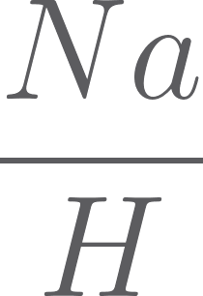
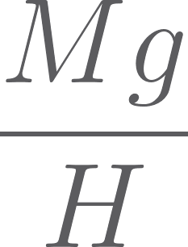

Results
Number Density Abundance
State | Na | Mg | Fe
Ground | 1.09e+15 | 1.96e+15 | 2.92e+17
Ionized to Neutral | 2487.28 | 21.37 | 16.64
Excited | 4.40e-2 | 1.27e-2 | 5.05e-2
Total | 2.83e+18 | 4.44e+16 | 2.61e+17
Na | Mg | Fe
6.63 | 4.83 | 6.91
0.33 | -2.71 | -0.57

Slide 11
Thanks!
Please keep this slide for attribution

